Slide 1
Using transformer to extract structure information for multi-sequences to boost function learning
Aihan Liu, Hsueh-Yi Lu
May. 2023

Slide 2
Introduction & Datasets

Slide 3
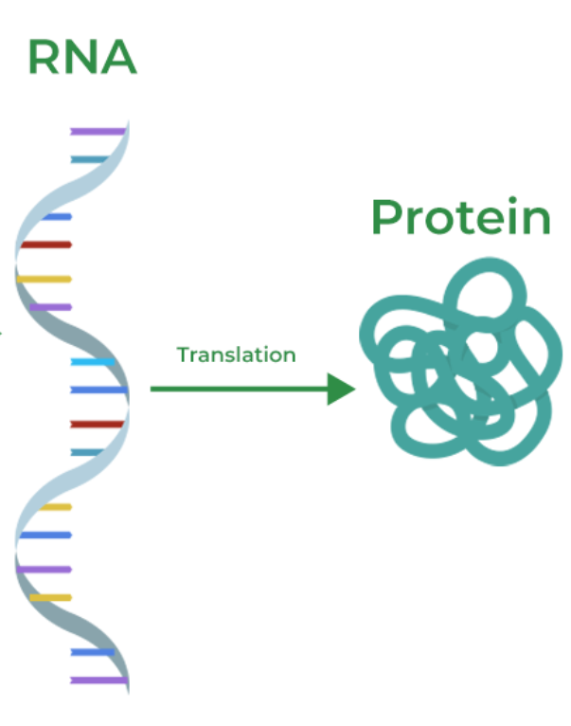
Introduction
Using transformer to extract structure information for multi-sequences to boost function learning
The rapid increase in the number of proteins in sequence databases has opened up more possibilities for machine learning-based structure and function prediction. However, the scarcity of data in RNA databases hinders the study of RNA.
Use transfer learning of transformers to extract structural information for RNA.
Enhances function learning, which is hindered by the lack of data in RNA databases.
Explores machine learning algorithms to identify important positions in genotype-phenotype associations
Explores Graph Convolutional Network learn complex structure-function relationships.
Notes:
Machine learning-based biocomputing methods have made breakthroughs in the field of proteins.Proteins are only one kind of biomolecule, and genes (DNA/RNA), as the source of proteins, contain more basic information and have more critical research value than the latter. The main reason is the lack of structural details because structure determines function; knowing the structure is necessary for the function to be inferred.
This project focuses on using transformers to extract structural information for multi-sequences, which enhances function learning in RNA. RNA utilizes four bases, and nucleotide-nucleotide interactions are crucial in determining RNA structure and function. Transfer learning from protein-based models can improve RNA contact prediction and deep learning algorithms can be used to identify and prioritize important positions in genotype-phenotype associations. The study also explores graph convolutional networks to learn complex structure-function relationships. The results indicate that machine learning-based structure and function prediction can provide explanations for RNA structure and open up avenues for new research in the field of molecular biology.

Slide 4
Concepts
Using transformer to extract structure information for multi-sequences to boost function learning
RNA sequences
RNA utilizes four bases (A, U, C, G). RNA sequence is a combination for these four nucleotides.
RNA contact
RNA pairwise structural proximity. If the physical distance is less than 10Å (angstrom, 1Å= 0.1nm) will be considered as "contact".
RNA functions
RNA molecules play numerous roles in both normal cellular processes and disease states.
RNA cuts
The number and distribution of intersecting contacts.
ACAAGGCUGACCGGAAAUCC
This is a presentation for capstone. After that, we have a report left.
This is a presentation for capstone.
After that, we have a report left.
Seq1: ACAAGGCUGACCGGAAAUC
Seq2: CAGAUUCGGACAGAACUGA
Fun1: Alpha variant
Fun1: Delta variant

Slide 5
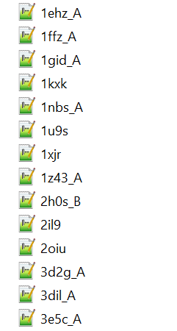
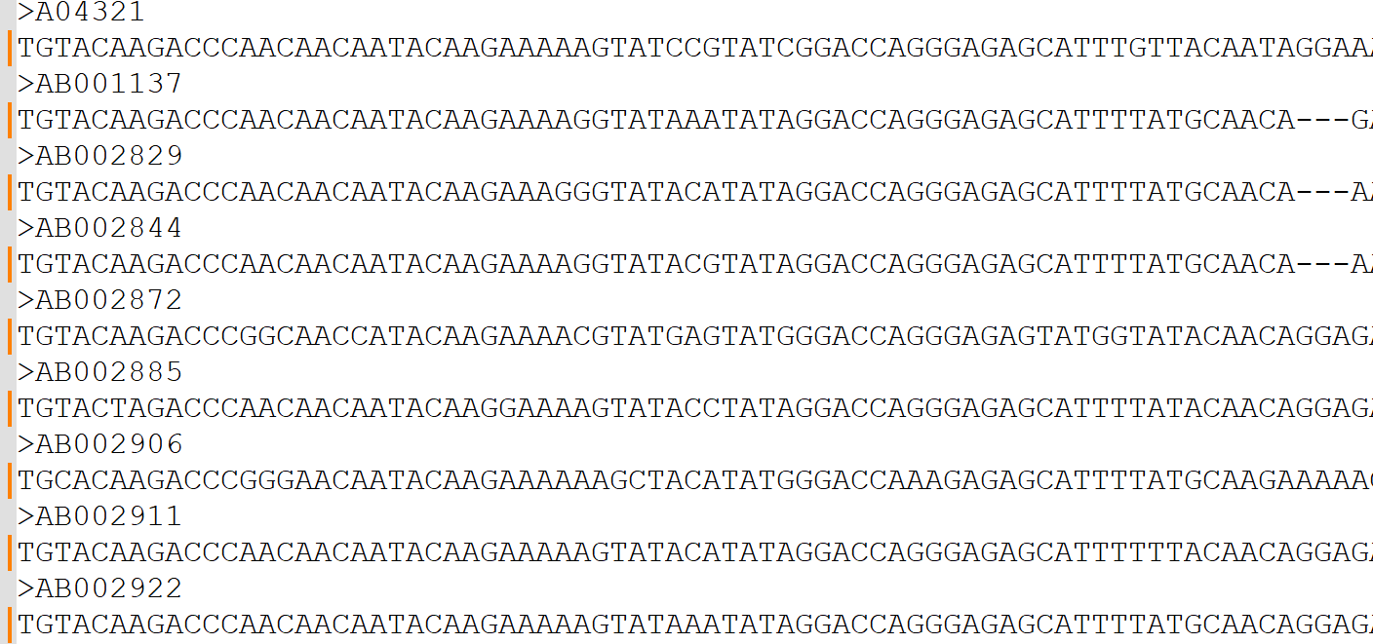
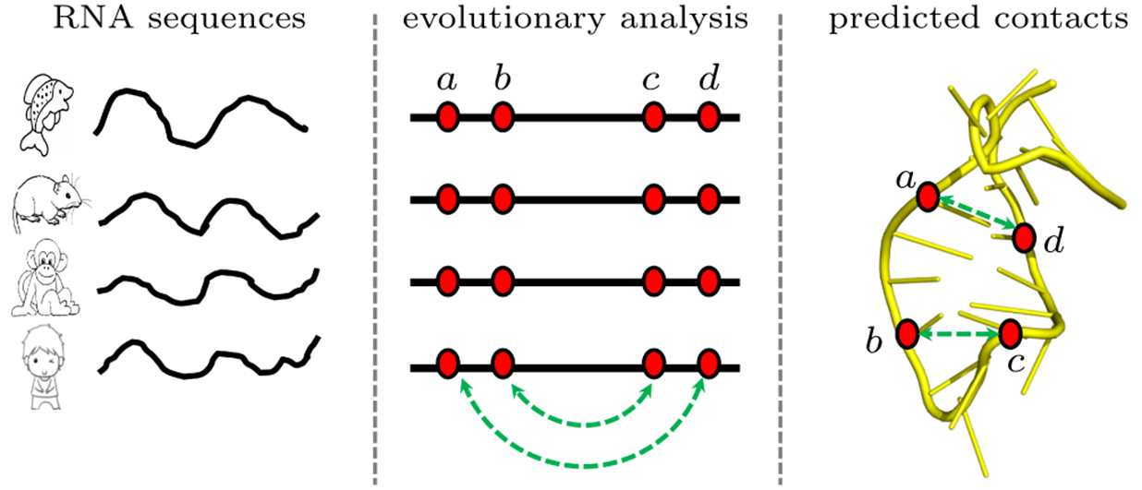
Dataset
RNA sequences
RNA name/identity
Unique ID/Description line
Sequence representation
RNA data to train(57)/test(23) transformers
RNA data with 6 different diseases. Each disease has different number of sequences with different functions.

Slide 6
Methods & Procedures

Slide 7
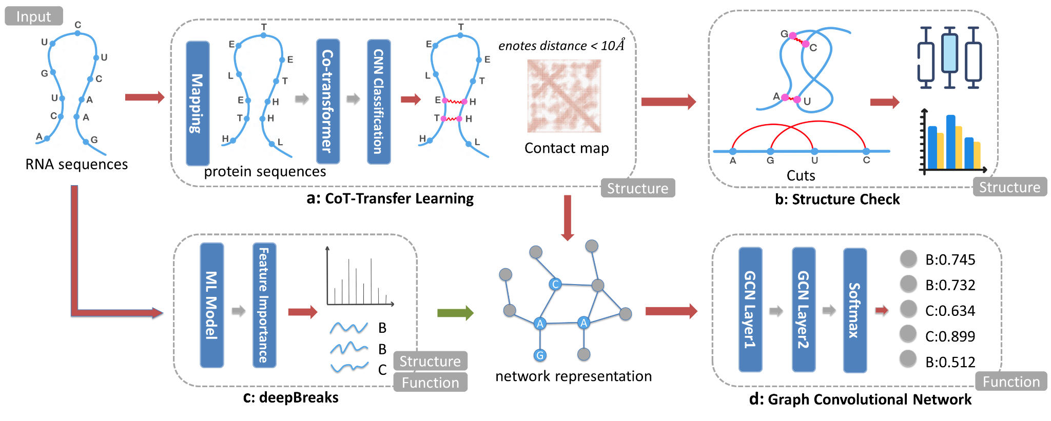
Workflow
a: A three-stage method to predict the RNA contact based on the protein co-transformer model.
b: Study of number and distribution for cuts from the prediction based on Co-Transferred result.
c: Used the deepBreaks to predict the function for RNA. The most important features could overlap with contact map, which provide an explainable result for RNA structure.
d: A GCN with two graph convolutional layers for learning complex structure–function relationships.

Slide 8
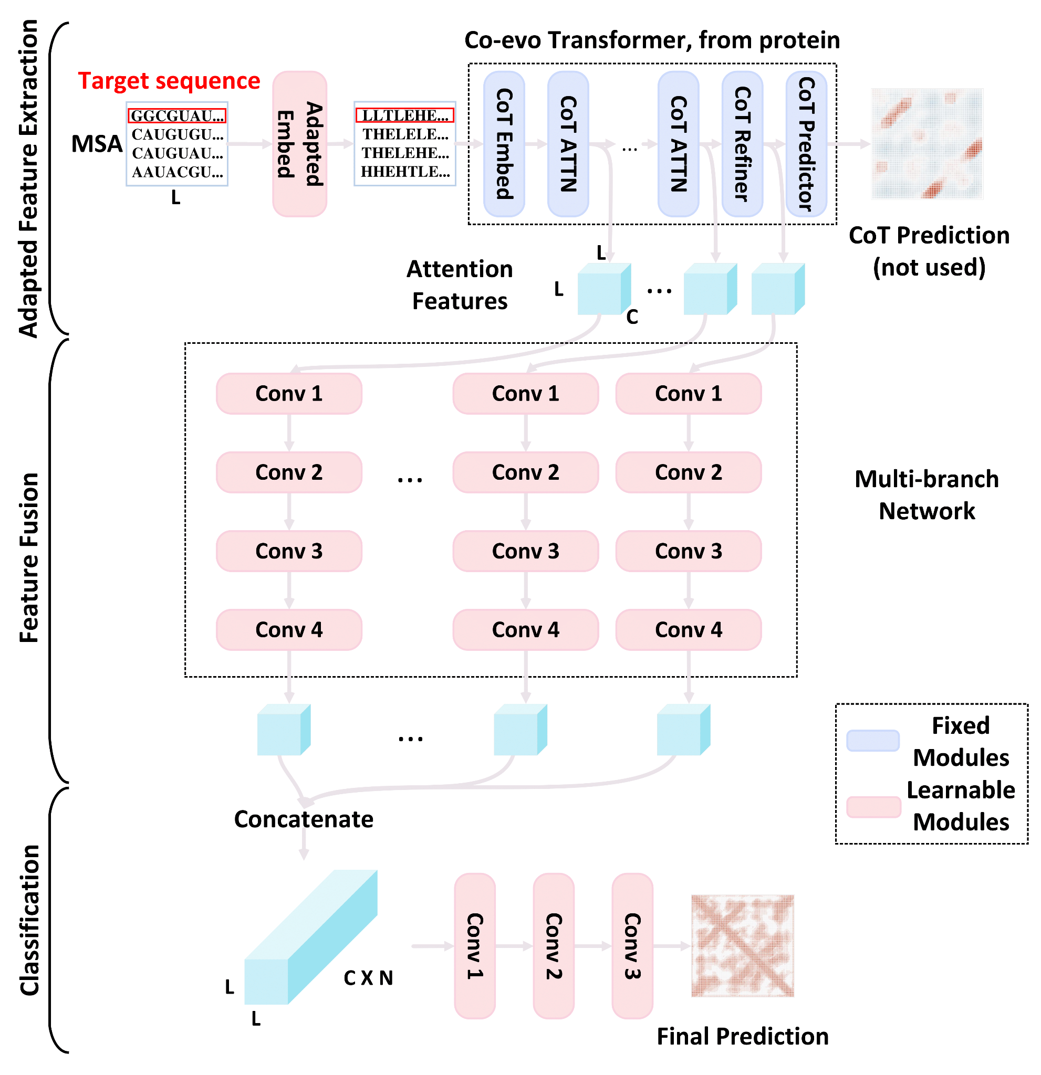
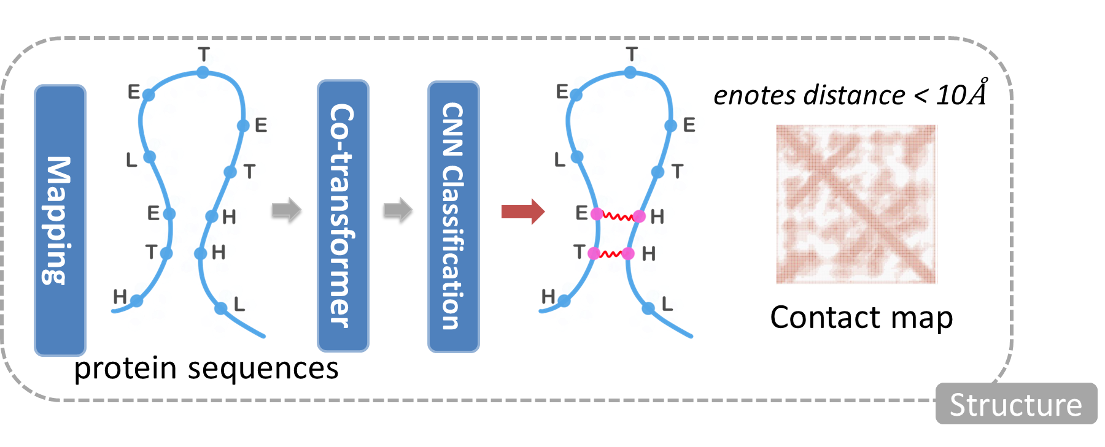
CoT-Transfer Learning
CoT-Transfer Learning is a transfer learning from a protein-coevolution-Transformer-based model which used pre-trained protein model to improve RNA contact prediction, reducing the data scarcity bottleneck for RNA structural prediction. This finding opens new avenues for research in transferring structural patterns from proteins to RNAs.
Achieved 73% of accuracy.

Slide 9
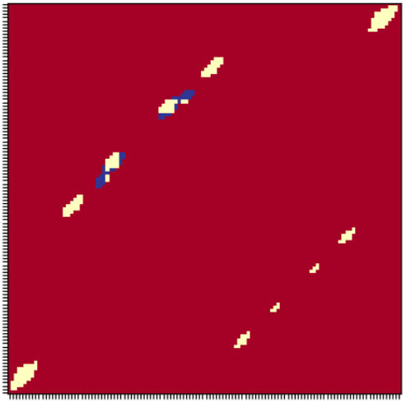
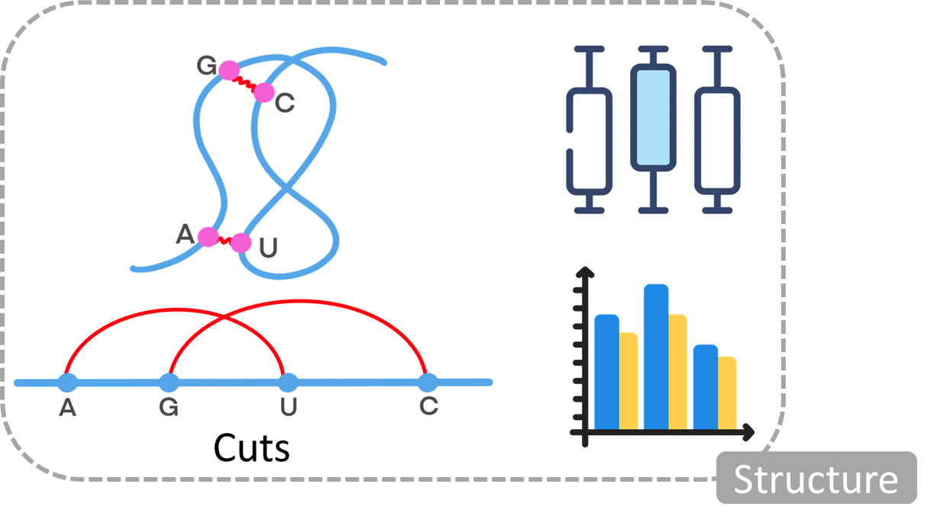
Structure Check - Cuts
The number and distribution of intersecting contacts.
Blue: Error
Red: No contact
Yellow: Correct
Contact metrix prediction
Notes:
In order to analyze the contact patterns of a protein, a crucial concept to understand is the definition of a "cut." A cut refers to the breaking of contact between two specific points on a RNA, and is determined based on whether or not a third point falls within the range of the initial two points. Specifically, a cut is identified when there is contact between point A and U, and there is also contact between point G and C. If either G or C falls within the range of A and U (A<= G <= U) or (A<= C <= U), then a cut is considered to have occurred. This definition allows for a precise understanding of the contact patterns within a protein and can aid in identifying key regions or structures.

Slide 10
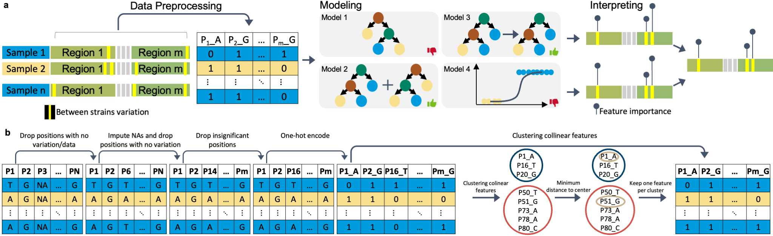
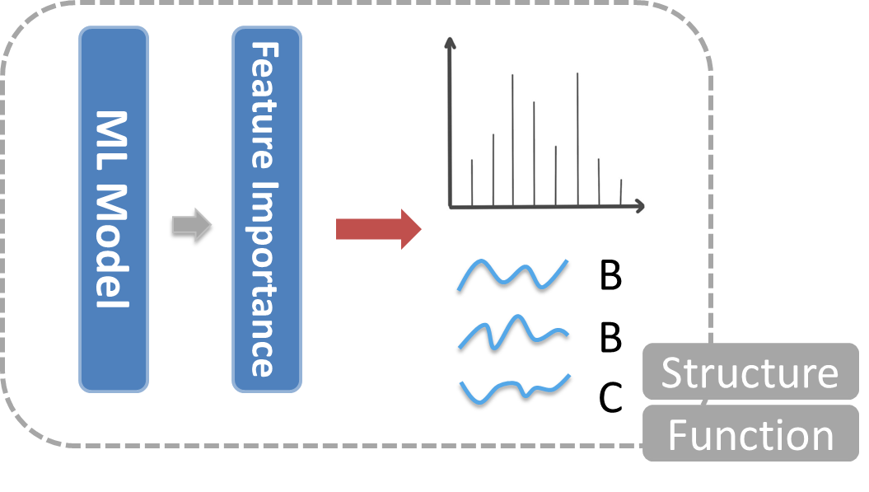
deepBreaks
A tool that uses machine learning algorithms to identify and prioritize important positions in genotype-phenotype associations by fitting multiple models and selecting the best one based on cross-validation score, and then using that model to predict the phenotype based on the provided sequence and interpreting it to find the most discriminative positions.
important position
Classification
Notes:
1.DeepBreaks is a computational method for identifying genomic regions and genetic variants significantly associated with phenotypes of interest.
2.It has been validated through synthetic data generation with known ground truth for genotype-phenotype association testing.
How deepBreaks works is that it transfer the data into position-base matrix and fit them into various machine learning models. After comparing the results, and show the important positions or points of the RNA sequence with the model that has the highest accuracy.
(This information can be incredibly useful in a variety of fields, including genomics, where identifying crucial genomic positions can provide insight into disease susceptibility and treatment options.)
(Overall, the identification of important positions can greatly enhance our understanding of complex systems and inform targeted interventions.)

Slide 11
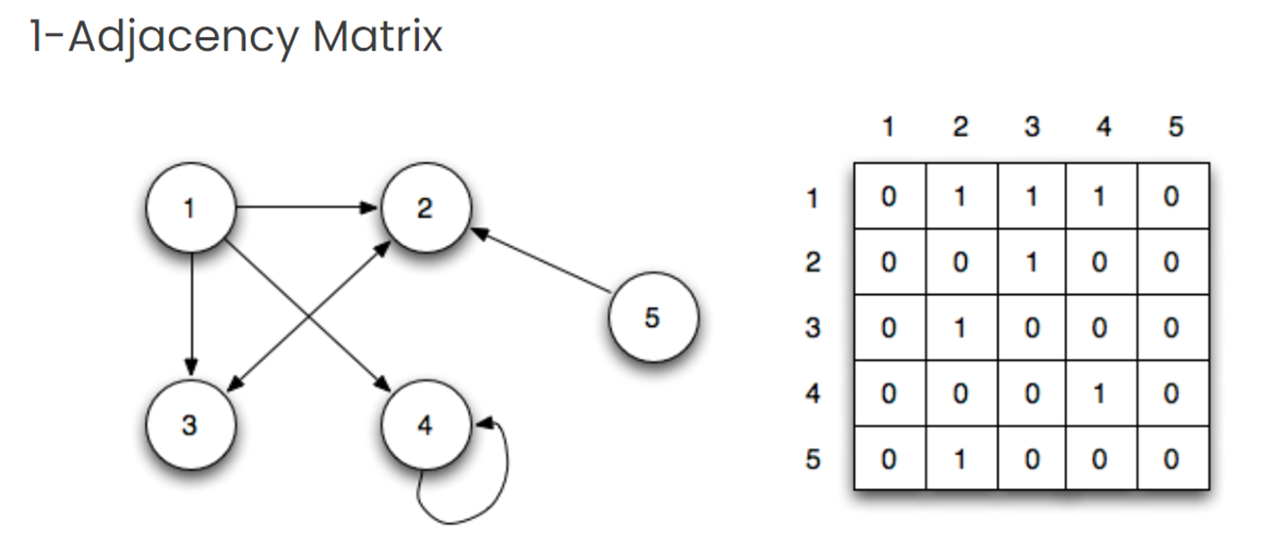
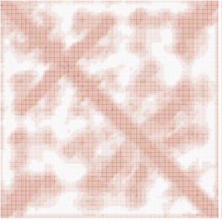
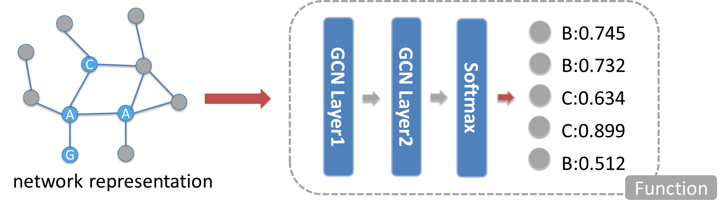
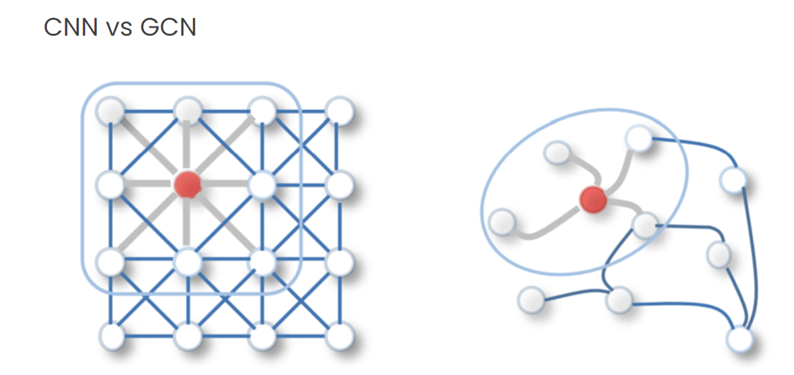
Graph Convolutional Network (GCN)
A neural network designed to work with graph-structured data. We use a convolutional operation to aggregate information from a node's local neighborhood, enabling effective learning and prediction tasks on graphs.
sequence + contact map
Classification
Notes:
Graph Convolutional Networks (GCNs) is a type of neural network designed to work with graph-structured data, such as social networks or molecular structures. A graph is a collection of nodes connected by link, and GCNs use a specialized convolution operation to learn and propagate information across the graph. This allows GCNs to capture both local and global patterns in the data, and to make predictions about nodes that have not been seen before. GCNs have become popular in recent years due to their ability to learn from complex and especially structured data.

Slide 12
Results & Conclusions

Slide 13
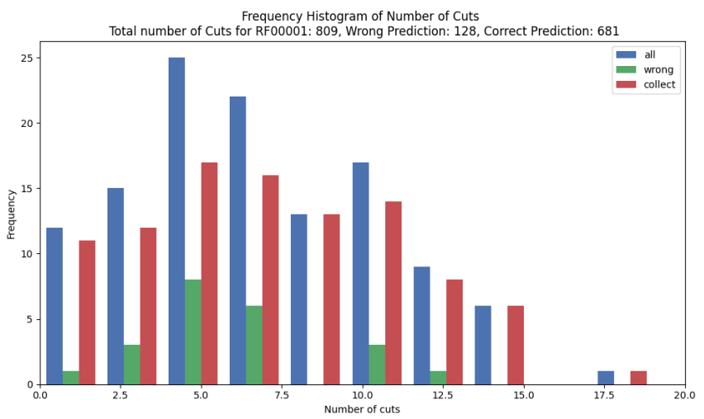
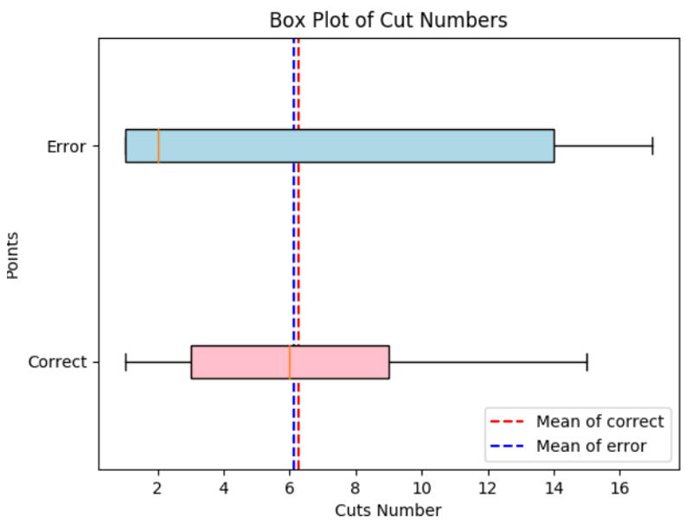
Results
Cut Numbers
Notes:
Based on the analysis of the distribution plots, it can be concluded that there is no significant difference between the distribution of the number of error cuts and the correct cuts. The plots show no distinct pattern or trend that can indicate a noticeable distinction between the two distributions. Therefore, it can be inferred that the error cuts and correct cuts have a similar distribution, and their frequencies are distributed evenly without any significant bias. These findings suggest that the error cuts may occur randomly, without any apparent pattern or correlation, and so, it may be challenging to predict their occurrence accurately.

Slide 14
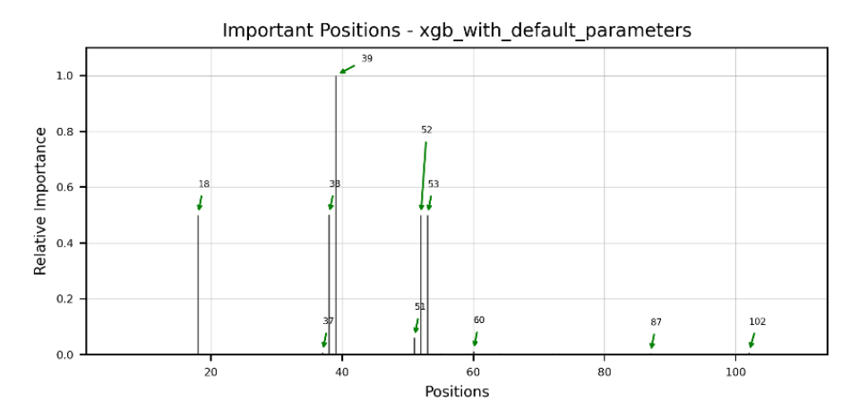
Results
deepBreaks
Certain positions appear significantly more relevant than others.
Logistic Regression
(with default parameters)-
99.25% Accuracy
Notes:
In analyzing a dataset, this plot is one of the model results generated by deepBreaks. This plot of position importance was generated, showing that certain positions are significantly more relevant than others.

Slide 15
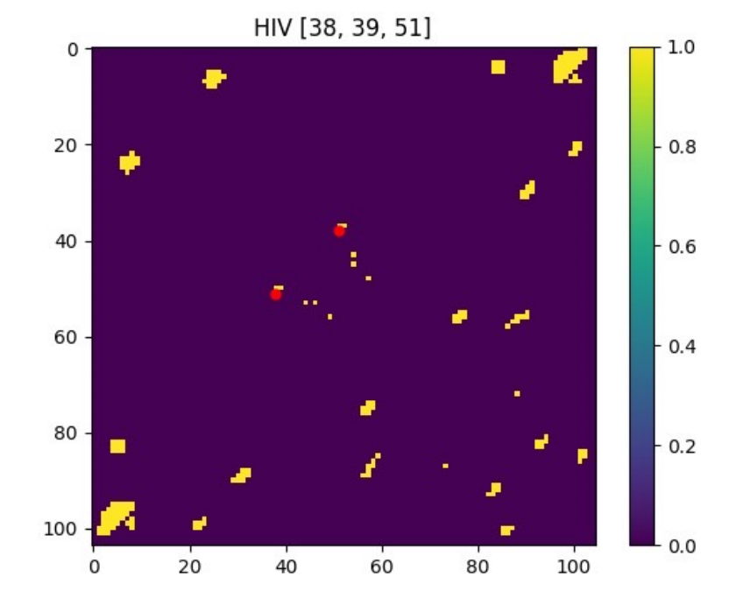
Results
deepBreaks
After identifying these important position, we compared them to the contact prediction and upon doing so we observed that some of these points match the contact matrix,
as shown by the red points in the figure.
Notes:
After identifying these important position, we compared them to the contact prediction and upon doing so we observed that some of these points match the contact matrix. The yellow points are the contact predictions, and the red points as shown in the figure is the ones that match the important position.

Slide 16
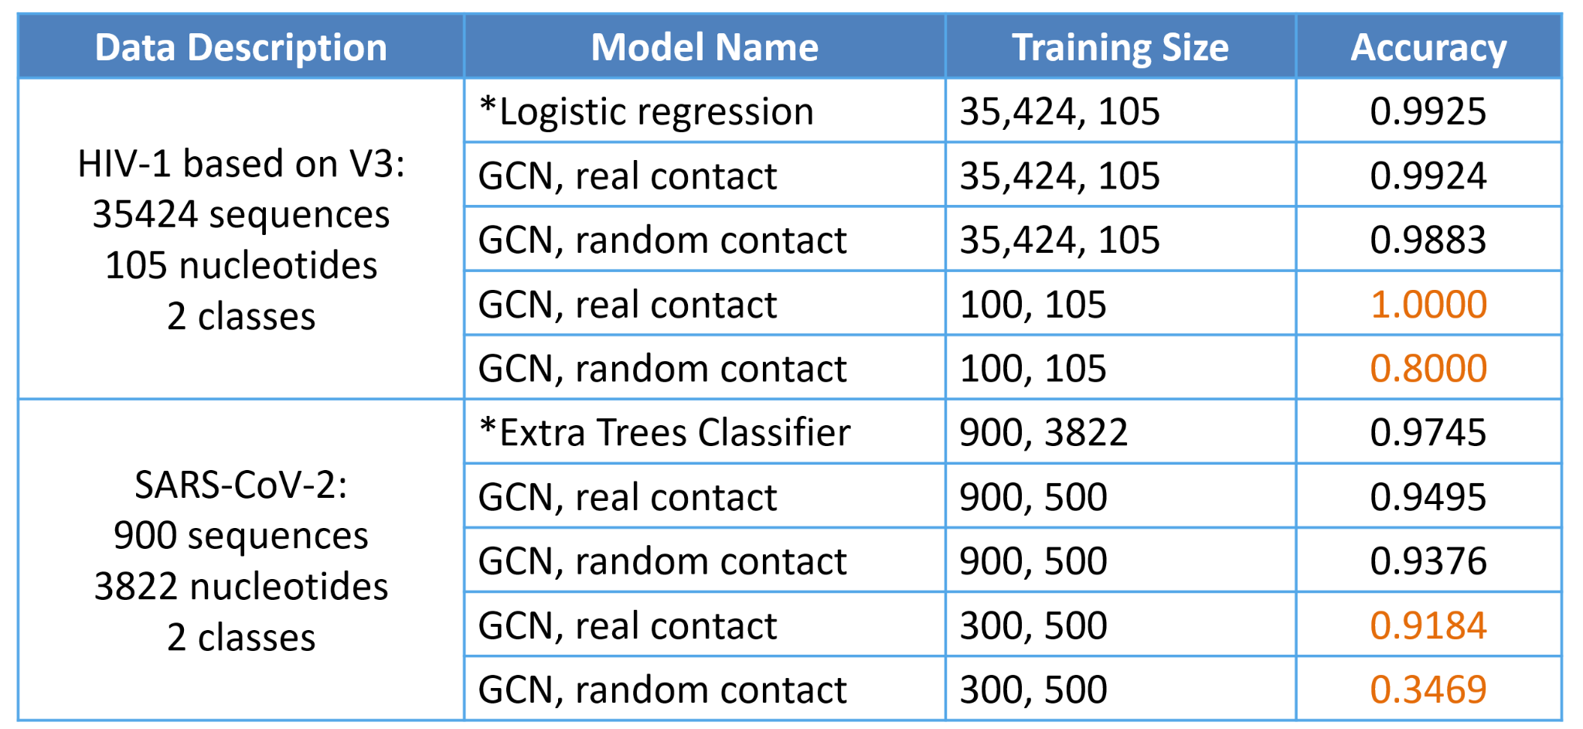
Results
GCN
With large samples for training, the contact doesn’t help increase prediction accuracy, and the type of nucleotides and order are more critical.
While if the number of samples is smaller, the contact significantly impacts the prediction of classification accuracy.
* Result from the best ML method provided by deepBreaks
Notes:
Based on the analysis of the data, it can be concluded that the impact of contact on prediction accuracy varies depending on the size of the sample used for training. In cases where a large sample is used, it appears that contact does not play a significant role in increasing prediction accuracy. Instead, the type of nucleotides and their order seem to have a more significant impact on the accuracy of predictions.
However, in cases where the sample size is smaller, it is clear that the inclusion of contact significantly impacts the accuracy of classification predictions. These findings highlight the importance of considering sample size when evaluating the impact of different variables on prediction accuracy.

Slide 17
Conclusion
The use of contact matrices and machine learning techniques shows great promise in advancing our understanding of RNA structure and function, potentially leading to new discoveries and breakthroughs in molecular biology.
CoT-Transfer learning from a protein-based model has the potential to improve RNA contact prediction, which can reduce the data scarcity bottleneck for RNA structural prediction.
Further study of cuts and their distribution is needed to better understand the structure of RNA gene sequences.
Graph convolutional networks (GCNs) designed to work with graph-structured data show great potential for effective learning and prediction tasks. GCNs require further research to optimize their structure, including the input for GCN, as well as finding methods for GCN explainability.

Slide 18
Conclusion
The deepBreaks machine learning tool can help identify and prioritize important positions in genotype-phenotype associations, providing an explainable result for RNA structure.
This approach can potentially be applied to other areas of bioinformatics and genomics research, such as protein structure prediction and drug design.
The scarcity of data in RNA databases hinders the study of RNA, but the rapid increase in the number of proteins in sequence databases has opened up more possibilities for machine learning-based structure and function prediction.
Notes:
In conclusion, the use of transformer-based models for predicting RNA contact and extracting structural information shows great potential for advancing our understanding of RNA structure and function. The combination of transfer learning, deep learning algorithms, and graph convolutional networks can provide more accurate predictions and better explainability of results. While there are still limitations in the length of sequences and the definition of cuts, further optimization and research in these areas can lead to new breakthroughs in the field of molecular biology. The results from this project provide a promising foundation for future studies in bioinformatics and genomics research, such as RNA structure prediction and furthermore, drug design.

Slide 19
Future Direction
● Optimize CoT-Transfer learning:
Including improving the mapping method and the transfer learning network. The method has a limitation on the length of sequence.
● Further study of cuts:
Our definition for cuts may not be appropriate. Theoretically, the more the number of cuts, the more complex the structure of RNA. There shouldn’t have too many cuts for RNA. It needs more research on the structure of the gene sequences.
● GCN structure:
The input for GCN is encoded nucleotides. If we apply another network to extract a "feature map" for the sequence, it may have better results for prediction.

Slide 20
Reference & Acknowledgement
We would like to thank our supervisor Professor Chen Zeng for his guidance and support throughout this project. We would like to express our appreciation to Professor Edwin Lo for his assistance in providing valuable insights into this research. Special thanks to our classmates for listening and providing suggestions into our research.
Reference:
Jian et al (Forthcoming), Knowledge from Large-Scale Protein Contact Prediction Models can be Transferred to the Data-Scarce RNA Contact Prediction Task, Nature Machine Intelligence (submitted) Rahnavard, A., Baghbanzadeh, M., Dawson, T., Sayoldin, B., Oakley, T., & Crandall, K. (2023). deepBreaks: a machine learning tool for identifying and prioritizing genotype-phenotype associations. Kipf, T. N., & Welling, M. (2016). Semi-supervised classifation with graph convolutional networks. arXiv preprint arXiv:1609.02907

Slide 21
Q & A

